Slide 1
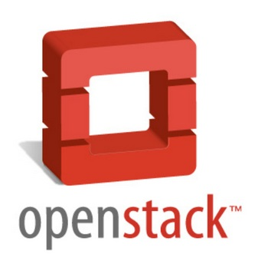
SDN in Openstack - A real-life implementation
Leo Wong

Slide 2
What is SDN
Programmability
Enable innovation / differentiation
Accelerate new features and services introduction
Application Layer
API
Centralized Intelligence
Simplify Provisioning
Optimize performance
Granular policy management
Control Layer
API
Abstraction
Decouple
HW / SW, Control Plane and Forwarding, Physical and Logical Config
Infrastructure Layer
Reference: ONF, Dan Pitt

Slide 3
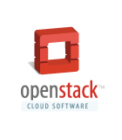
What is OpenStack?
Open Source Cloud Software…
A collection of “cloud services”
Each service includes:
A tenant-facing API that exposes logical abstractions for consuming the service.
One or more backend implementations of that API
Reference: Intro to Openstack Quantum, by Dan Wendlandt

Slide 4
Openstack Services
*-as-a-Service Capability
OpenStack Service
Compute
Nova
Cinder (Block)
Storage
Swift (Objects)
Glance (Images)
Network
Quantum

Slide 5
Problem #1: Technology Limitations
Cloud stresses networks like never before:
High-density multi-tenancy, massive scale
Strict uptime requirements.
Integrate with legacy hosting environments / remote data centers.
Price pressure to use commodity gear.
VM mobility
Nova provides only basic technologies:
VLANs are only option for multitenancy
Used simple Linux Bridge (no advanced QoS, ACLs, or monitoring)
“network controller” node is centralized single-point of failure for large networks.
VLANs are Great!
- Stone Age Man

Slide 6
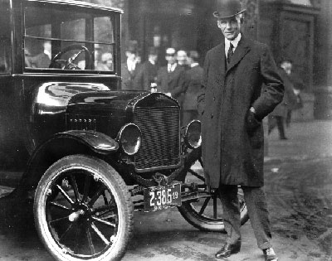
Problem #2: No Tenant Control
Cloud tenants want to replicate rich enterprise network topologies:
Ability to create “multi-tier” networks (e.g., web tier, app tier, db tier)
Control over IP addressing.
Ability to insert and configure your own services (e.g., firewall, IPS)
VPN/Bridge to remote physical hosting or customer premises.
Nova provides no tenant control:
No way to control topology.
Cloud assigns IP prefixes + addresses.
No generic service insertion.
“You can have any color as long as its black.“
- Henry Ford about the Model-T

Slide 7
Quantum Basics (by analogy to Nova)
 | Nova | Quantum
*-as-a-service | Compute | Network
Major API abstractions | “virtual servers”: represents a host with CPU, memory, disk, and NICs. | “virtual networks”: A basic L2 network segment. “virtual ports”: Attachment point for devices connecting to virtual networks.
Interactions with other OpenStack services. | virtual servers use “virtual images” from Glance. | virtual ports are linked to vNICs on “virtual servers”.
Supports different back-end technologies | “virt-drivers” for KVM, XenServer, Hyper-V, VMWare ESX | “plugins” for Open vSwitch Cisco UCS, Linux Bridge, Nicira NVP, Ryu Controller.
API Extensibility for new or back-end specific features. | keypairs, instance rescue, volumes, etc. | quality-of-service, port statistics, security groups, etc.
Notes:
Common to run both Quantum and Nova on the same set of controller hosts.

Slide 8
Old Model: Static Nova Networking
TenantA-VM1
88.0.0.2
TenantB-VM1
88.0.0.3
TenantA-VM2
88.0.0.4
TenantA-VM3
88.0.0.5
Public Net
88.0.0.0/18
Single network exists (per-project or global).
VMs automatically get a vNIC on that single network on boot.
Tenants have no control over IP addressing.

Slide 9
Model: Dynamic Network Creation + Association
TenantA-VM1
10.0.0.2
TenantA-VM2
10.0.0.3 9.0.0.3
TenantA-VM3
9.0.0.2
Tenant-A Net1
10.0.0.0/24
Tenant-A Net2
9.0.0.0/24
Load Balancer
Public Net
88.0.0.0/18
Tenant can use API to create many networks.
When booting a VM, define which network(s) it should connect to.
Can even plug-in instances from other services (e.g., a load-balancing service).

Slide 10
Implementation - Logical Flow
Horizon
Internet
Quantum
NW Node (L3, LB)
BW Controller
OVS
Internal L2
Network
OVS
KVM
OVS
KVM

Slide 11
Implementation - IP Addressing
NS:yyy-yyy-yyyy
IP:192.168.0.10
NS:xxx-xxx-xxxx
IP:192.168.0.10
OVS
NS:yyy-yyy-yyyy
IP:192.168.0.11
NS:xxx-xxx-xxxx
IP:192.168.0.11
GRE
OVS
GRE
GRE
NS:yyy-yyyy-yyyy
IP:192.168.0.1
NS:xxx-xxx-xxxx
IP:192.168.0.1
Public IP
NAT
203.199.199.10->NS:xxx-xxx-xxxx/192.168.0.10
203.199.199.11->NS:yyy-yyy-yyyy/192.168.0.10
Network Node

Slide 12
Implementation – API Flow
Quantum API
Quantum
Nova
Nova-Compute
Quantum Controller
libvirtOVS
Plugin
OpenvSwitch
DB
Hypervisor
OVS
OpenvSwitch
Network Services (DHCP, L3, NAT, FW, LB)

Slide 13
Future Implementation
Quantum API
Quantum
Nova
Nova-Compute
Quantum Controller
libvirtOVS
Plugin
OpenvSwitch
DB
Hypervisor
OpenFlow Controller API (REST)
OpenFlow Contoller
OpenFlow-enabled Network Device

Slide 14
Demo

